Slide 1
Pupil Reward Points
Lawford Education Ltd
Improved motivation, higher achievement, better communication.

Slide 2


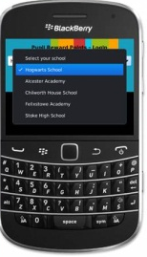

Awarding points
Teacher
Student
Points Top-up
Mr. Ballard
This card is worth 2 points
3376-7354-9133-7994

Slide 3
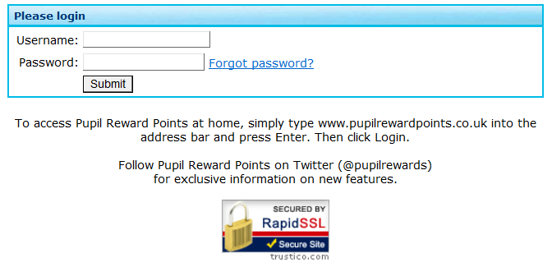
Awarding points online…
Let’s login as a teacher…
mr.smith

Slide 4
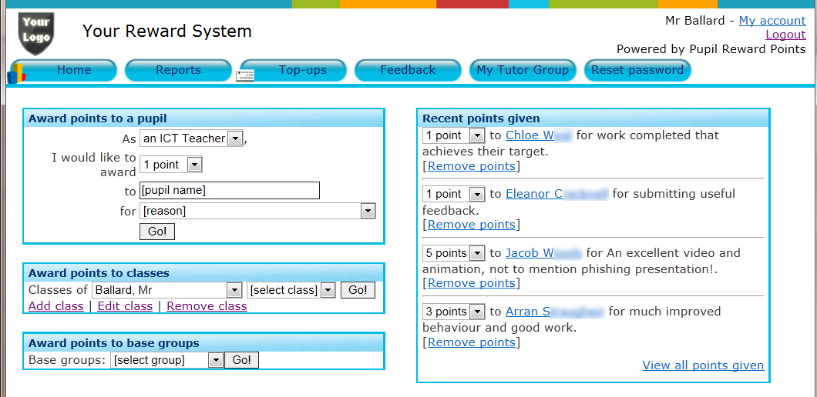
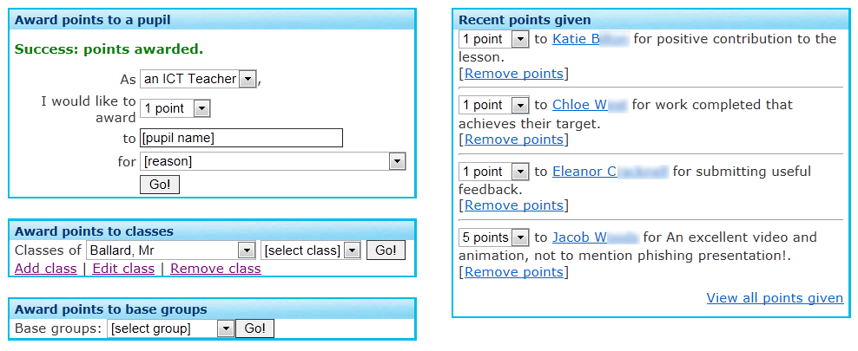

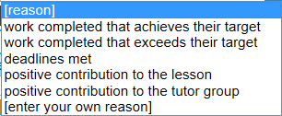
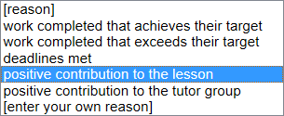
Awarding points is easy…
1. Select which subject you are teaching and choose how many points to award
Ka
2. Type in the first few letters of a student’s name
Katie B 
Kayleigh B
Katie B
Katie B
Katie F
Kai B
Once points have been awarded, it’s easy to make a change, if needed
3. Select from a list of reasons decided by your school or choose to type in your own reason

Slide 5
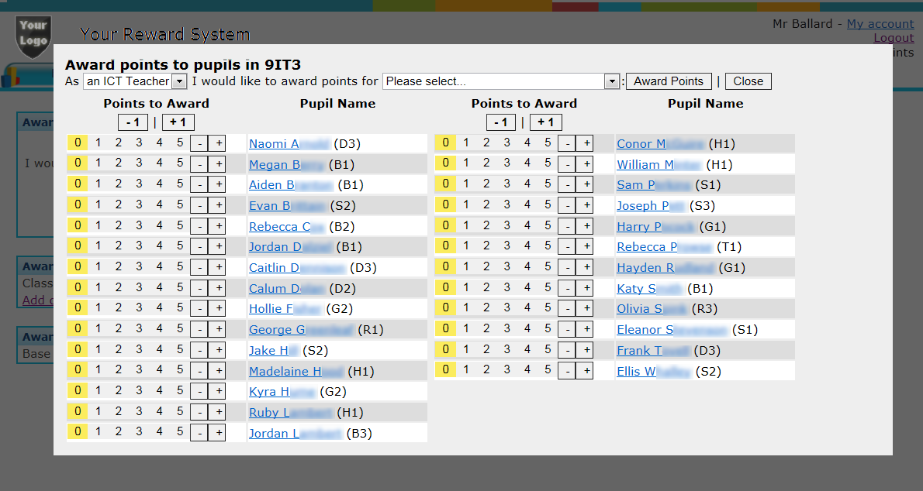






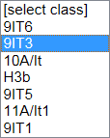
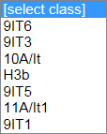
Awarding points to an entire class is simple using our innovative point scale…
Your classes are here

Slide 6
Awarding points using top-up vouchers…
The student then enters the code to top-up their account with points
They work like a mobile phone top-up
Points Top-up
Mr. Ballard
This card is worth 2 points
3376-7354-9133-7994
Just print out then hand out

Slide 7
Thank you for watching

