Slide 1
Pupil Reward Points
Lawford Education Ltd
Motivate, Communicate, Reward

Slide 2
Awarding points online…
If using SIMS, points can be awarded via your SIMS register.
Points can also be awarded via points vouchers. More on this in a moment.
mr.smith
Let’s sign in as a teacher…
If your school uses Office 365 or Google logins, you can use your existing login.

Slide 3
There is a Table view, which allows you to group pupils and award points to groups of pupils at the same time. Great for group work.
There is a List view, which allows you to award points to all pupils in your class at once.
If you are a secondary school teacher, you will see your timetable.
Click on a lesson to see your students.
If you are a primary school teacher, you should see the names of your children.
To award points to an individual pupil, just click on their name then select a reason.
Once points have been awarded, they appear in the “Recent Points Awarded” box. They can easily be removed.

Slide 4
Awarding points using top-up vouchers…
They work like a pay as you go mobile phone top-up, except they top-up with points and not credit.
The student then enters the number to top-up their account with points.
Points Top-up
Mr. Ballard
This card is worth 2 points
3376 - 7354 - 9133
Just print them, then hand them out.
Vouchers may have barcodes so that they can be scanned, which is quicker and easier than typing the number.

Slide 5
Using Points Top-up Vouchers…
Top-up vouchers are an alternative way of awarding points. They can be printed in advance, which means they can be used as a quick and easy way of rewarding a pupil without needing to use a computer.
Just print them using a standard printer and then hand them out
The pupil then enters the unique number to top-up their account with points.
…or print them on labels for sticking into books.
You can purchase barcode scanners so pupils do not need to type the number.

Slide 6
Other useful information

Slide 7
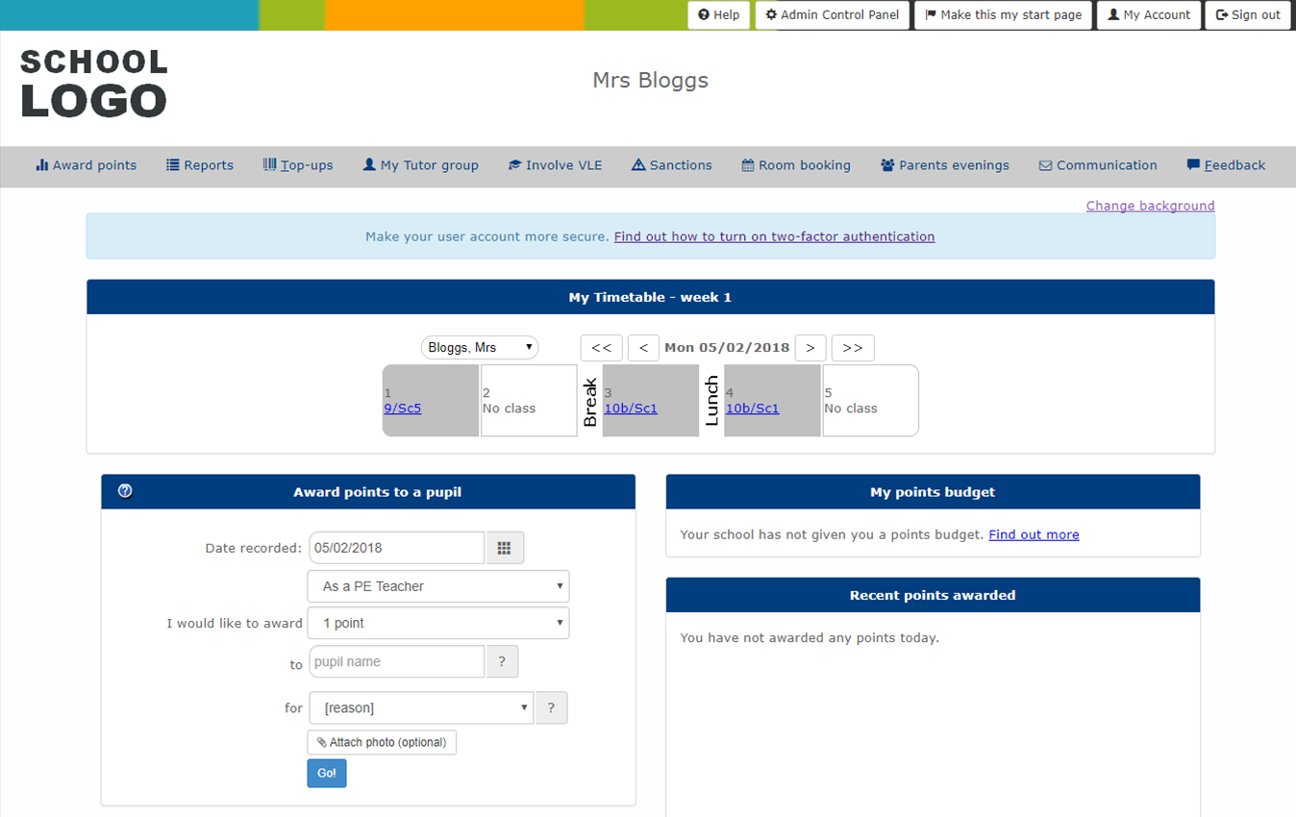
- Only an administrator will see this link. However, your school can have as many administrators as needed.
- Explore the Reports. They have lots of useful features including leaderboards, charts showing house points, buttons to make points certificates, analysis of significant groups etc.
- Go to the Top-ups page to print your own Top-up vouchers.
- To change your password, go to the My Account page.
- Use the Manage My Classes button to add your own student groups or after school clubs. These can be composed of pupils in different classes and year groups.

Slide 8
Use the Feedback form for questions or to report any issues. This will send an email to the system administrator at your school and the Pupil Reward Points team so that we can reply swiftly and take any necessary action.
Your school may decide to purchase additional features such as our parents evening booking system to easily manage teacher / parent meetings.

Slide 9
Thank you for watching

