Slide 1
Pupil Reward Points
Your new rewards system

Slide 2
Your own login to see your achievements…
Joe.bloggs
Let’s login now…

Slide 3
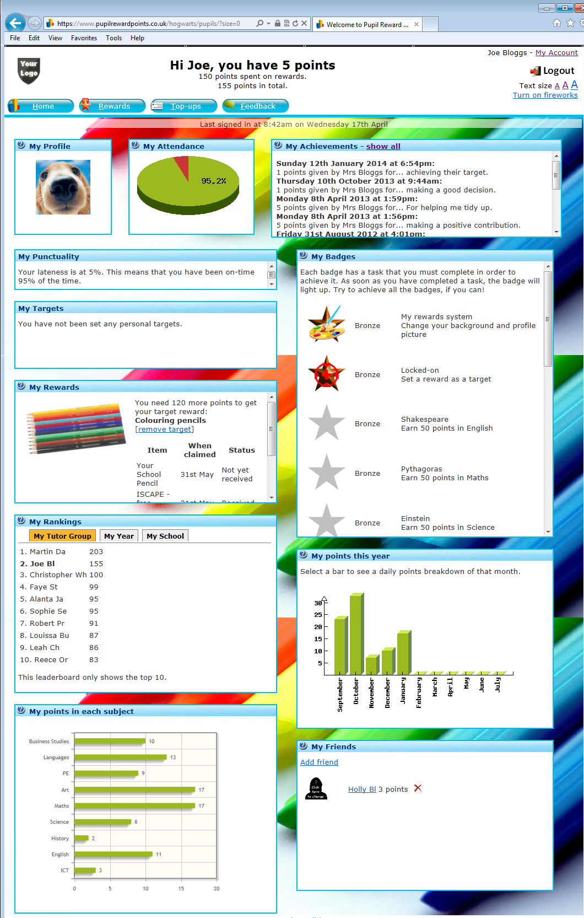

Slide 5
Buy rewards with your points
List examples of your school’s rewards here and add some pictures.

Slide 6
So how do you get points?
By being a good student:
Be here and be on time
Try your best
Contribute towards the lesson
Attend after-school clubs
Help at school events

Slide 7
Thank you for watching

